Slide 1
DAILY ENGLISH SPEAKING FOR BEGINNERS

Slide 2
LESSON 9

Slide 3
Contacts
Daily conversation dialogues

Slide 4
Let's find the topic of conversations and split into groups and read the dialogues

Slide 5
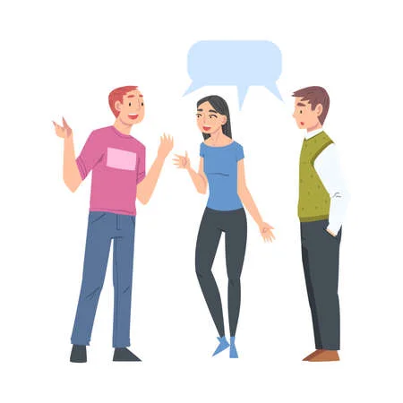
Jane: Good morning, Doctor Rudra, how are you doing?
Doctor Rudra: Good morning, Jane. I am doing well. And you?
Jane: I’m great, thank you. This is my friend Leila. She is thinking about joining the hospital but she has a few questions about the administration there. Would you mind telling her about the administration, please?
Doctor Rudra: Hello, Leila! It’s a pleasure to meet you. I’m more than happy to speak with you. Please stop by my chamber tomorrow.
Leila: It’s a pleasure to meet you, Doctor. Thank you so much for helping us.
Doctor Rudra: Don’t mention it. Hopefully, I will be able to help you out in this matter.

Slide 6
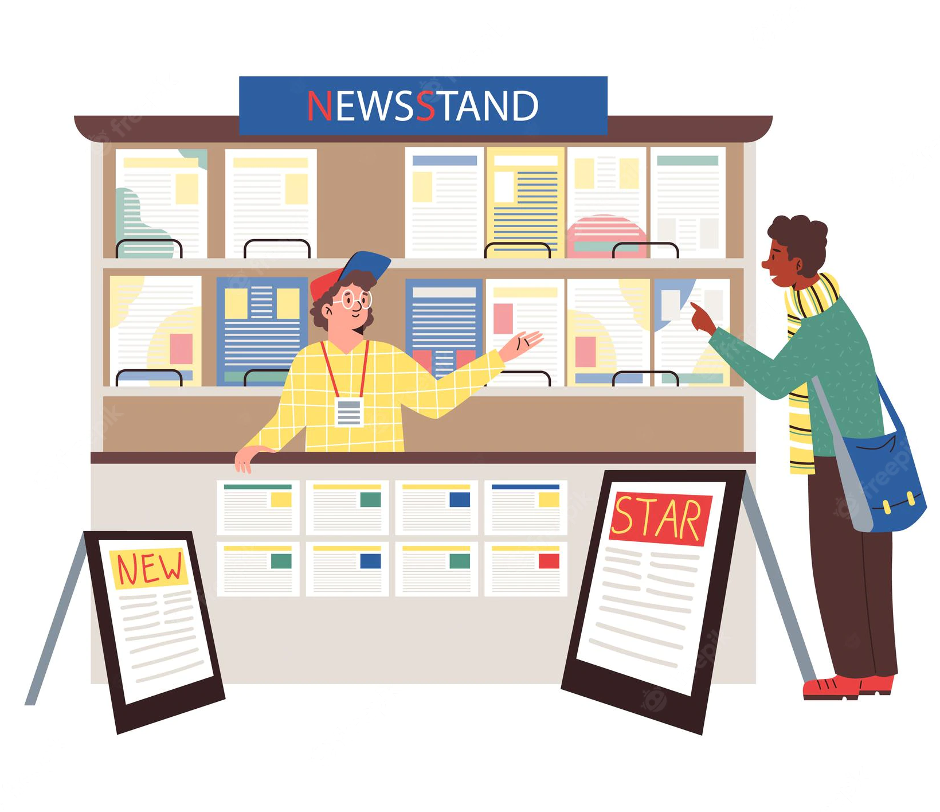
Shopkeeper: Hi. Can I help you?
Gemma: Hello. How much is this magazine?
Shopkeeper: Let’s see … Top Sounds, that’s £1.99.
Gemma: OK, can I have the magazine and do you have a bottle of water?
Shopkeeper: Yes.
Gemma: Have you got cold ones?
Shopkeeper: Over there in the fridge. Is that everything?
Gemma: I think so. Oh … and these sweets.
Shopkeeper: OK.
Gemma: How much is that?
Shopkeeper: That’s £3.40, please.
Gemma: Here you are.
Shopkeeper: Thank you … and there’s £1.60 change. Would you like a bag?
Gemma: No, it’s fine, thanks. Bye.
Shopkeeper: Bye.

Slide 7
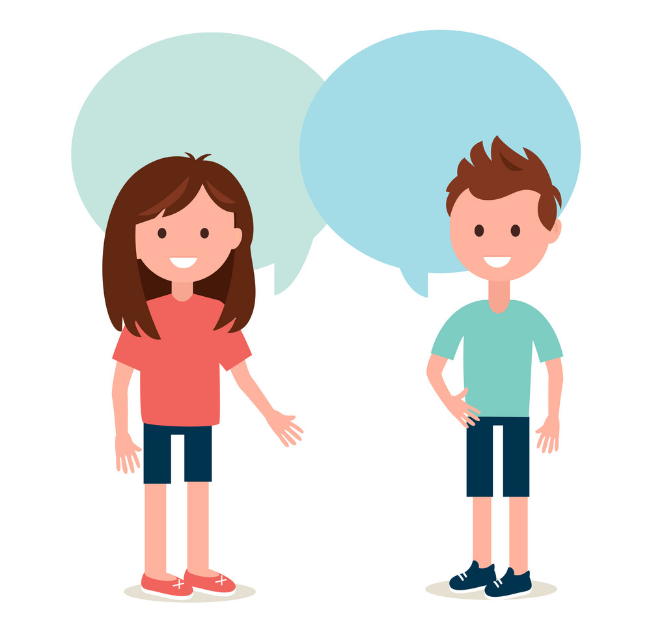
A: I wish it was a nicer day today.
B: That is true. I hope it doesn't rain.
A: It wouldn't rain in the middle of the summer.
B: It wouldn't seem right if it started raining right now.
A: It would be weird if it started raining in ninety degree weather.
B: Any rain right now would be pointless.
A: That's right, it really would be.
B: I want it to cool down some.
A: I know what you mean, I can't wait until it's winter.
B: Winter is great. I wish it didn't get so cold sometimes though.
A: I would rather deal with the winter than the summer.
B: I feel the same way.

Slide 8
Rann: “Hey Harry, how have you been? Long time no see!”
Harry: “Hey! What a surprise! Yes, you are right, we haven’t seen each other in a long time. How have you been?”
Rann: “There is an important campaign next week which is keeping me busy otherwise rest is going good in my life. How about you?”
Harry: “Oh! I just finished a meeting with a very important client of mine and now I finally have some free time. I feel relieved that I’m done with it.”
Rann: “Good for you then. Hey! Let’s make a plan and catch up with each other after next week. What do you say?”
Harry: “Sure, why not”? Give me a call when you are done with your project.”
Rann: Sure, then. Bye, take care.
Harry: Bye buddy.

Slide 9
Marry: Good morning Mr. David, I’d like you to meet Dr. John.
Mr. David: Good morning. It’s nice to meet you, Dr. John.
Dr. John: Pleasure to meet you, too.
Marry: Dr. John is from the UK. He just finished writing a book on cancer prevention.
Mr. David: I also belong to that field. I work for the United Nations.
Dr. John: If I am not wrong, are you from the development program team?
Mr. David: Yes you are right but how did you know?
Dr. John: I’ve read some of your previous articles. They’re very good.

Slide 10
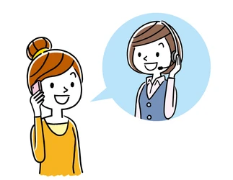
Telephonic Dialogues for Everyday Conversations in English
Rancho: Hi, Aditi, it’s Rancho. How are you? What are your plans for today?
Aditi: Oh, hi, Rancho! I was just thinking about giving you a call. Well, I am free today, what about you?
Rancho: That’s nice. I was wondering if you’d like to go to a dinner party tonight
Aditi: Sure, I’d love to! Where is the party?
Rancho: It’s in the Park Hotel?
Aditi: Sounds great!
Rancho: Ok I’ll pick you up around 8:30. We will probably reach the hall by 9 p.m.
Aditi: Great! See you then. Bye!

Slide 11
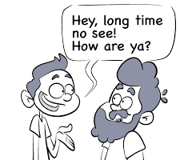
Srini: Hey!, hello there, Jenny! Long time no see!
Jenny: Srini! Hi! Wow! What a coincidence! It’s been ages that I haven’t seen you! What are you doing here?
Srini: Yes Jenny, you are right. Probably the last time we met was in 2006. Well, I just got a new job in the city, so I’m shopping for some trousers. Hey, what do you think of these trousers?
Jenny: Hmmm … well, you know how much I love black. See? I am even wearing a top of the same colour!
Srini: Yes I already noticed that. You always did have good taste!

Slide 12
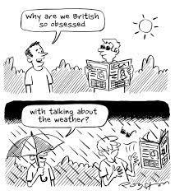
Jenny: It’s like flooding outside! What happened to the weather report? I thought this depression was supposed to pass.
Kim: Yeah, we all thought so too. That’s what I read online this morning. I missed my office for this too.
Jenny: I guess a thunderstorm is on its way too.
Kim: Can we go inside? I am already half wet!

Slide 13
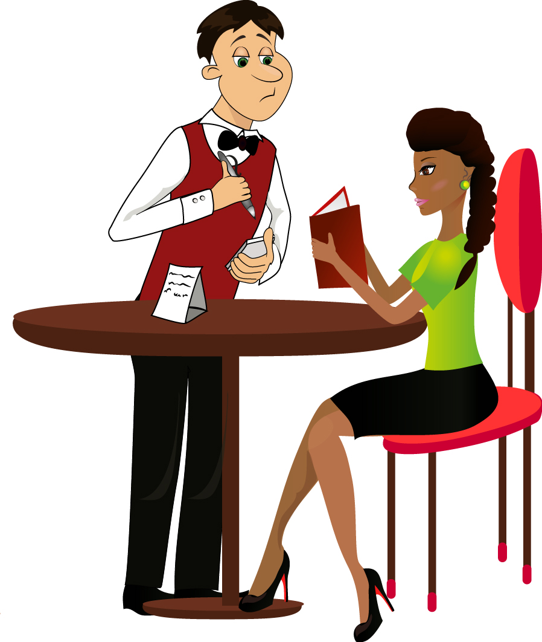
Waiter: Hello, good evening. Can I start you off with some refreshing drink?
Rana: Yes. I’ll have iced tea, please.
Amal: And I’ll have a chocolate cold coffee.
Waiter: Ok. Should I take your order now, or do you need a few minutes more?
Rana: No we are ready, you can take the order. I’ll have the corn mushroom soup to start, and the grilled chicken with mashed potatoes and peas. And, please also bring a bowl of garlic rice.
Waiter: Sure sir. How do you want the chicken— low spicy, medium, or high on spice?
Rana: Medium spice, please.
Amal: And I’ll just have the beef, with bread and a salad.

Slide 15
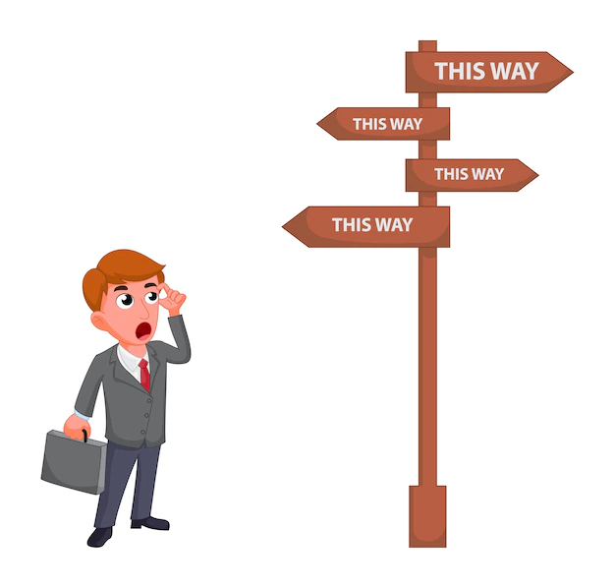
Magnolia: Excuse me. Could you tell me where the shopping mall is?
Neha: Yes, it’s that way. You go two blocks to Beckham Street, then turn left. It’s in the second building, across from the library.
Magnolia: Thank you so much! I’ve only been in town two days ago, so I really don’t know my way around yet.
Neha: Oh, I totally understand how you feel. I also moved here a year ago for my job, and still, I don’t know where everything is!

Slide 16
IT'S TIME FOR AN IDIOM EVERY DAY
Hit the road
To leave or start a journey.

Slide 17
TODAY’S VOCABULARY
Let's write down the words we already know or what we remember from today's lesson.

Slide 18
Create your own dialogue

Slide 19
Even if we finish today's lesson here, here are some suggestions for integrating English into your daily life:
Watching: On YouTube (English Conversation)
https://www.youtube.com/watch?v=m1-Bx3h4cio&t=10s
Listening: Podcast “Fluency Fix's Beginner English, Thinking of English)
https://open.spotify.com/episode/4O9JStUhmzDI0WXBknnD04
https://open.spotify.com/show/2OwAg0ckS0mUDPi6HW8FNt
Phone app: Download “Duolingo, Voscreen, Busuu, Memrise, Mondly)
.

Slide 20
Thank you for your participation.
ANY QUESTIONS?
Have a good week. Hope to see you next week.

