Slide 2
DAILY ENGLISH SPEAKING FOR BEGINNERS

Slide 3
LESSON 7

Slide 4
Contacts
Weather/Seasons

Slide 5
WEATHER TYPYES

Slide 8
What’s the Weather Like?

Slide 9
Example 1: How's the weather?
It is snow (noun). incorrect
It is snowy (adjective). correct
It is snowing (verb). correct

Slide 10
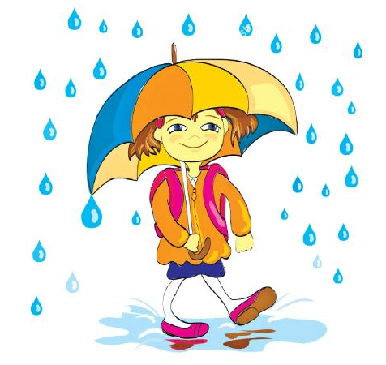
Example 2: What's it like out?
It is rain (noun). incorrect
It is rainy (adjective). correct
It is raining (verb). correct

Slide 11
Example 3: What's the weather like?
It is sun (noun). incorrect
It is sunny (adjective). correct
The sun is shining (verb). correct

Slide 16
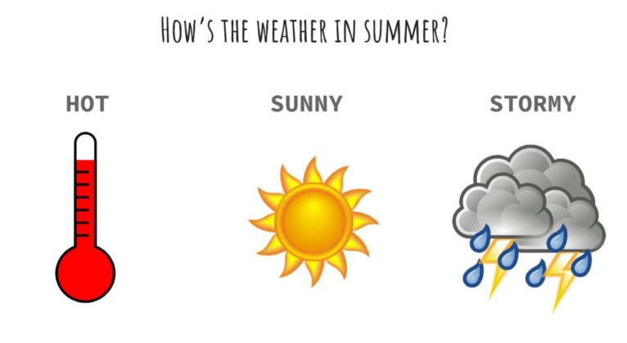

Slide 18
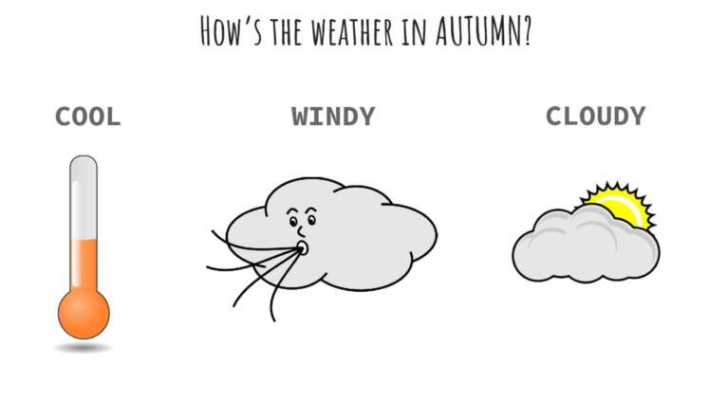

Slide 23
IT'S TIME FOR AN IDIOM EVERY DAY
It’s raining cats and dogs
Something that you say when it is raining heavily.

Slide 24
TODAY’S VOCABULARY
Let's write down the words we already know or what we remember from today's lesson.

Slide 25
What's your favourite weather?

Slide 26
Even if we finish today's lesson here, here are some suggestions for integrating English into your daily life:
Watching: On YouTube (English Conversation) https://www.youtube.com/watch?v=m1-Bx3h4cio&t=10s
Listening: Podcast “Fluency Fix's Beginner English, Thinking of English)
https://open.spotify.com/episode/4O9JStUhmzDI0WXBknnD04
https://open.spotify.com/show/2OwAg0ckS0mUDPi6HW8FNt
Phone app: Download “Duolingo, Voscreen, Busuu, Memrise, Mondly)
.

Slide 27
Thank you for your participation.
ANY QUESTIONS?
Have a good week. Hope to see you next week.

