Slide 1
DAILY ENGLISH SPEAKING FOR BEGINNERS

Slide 2
LESSON 6

Slide 3
Contacts
Time
Hobbies/Free time
06.01.2023

Slide 4
Let's learn to tell time

Slide 7
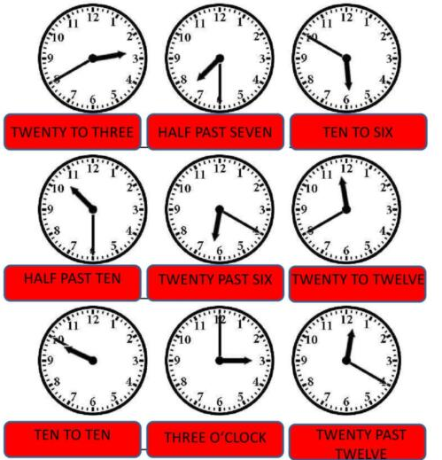
What is the time? What time is it?

Slide 8
What time is it?
- It’s five o’clock

Slide 9
What time is it?
- It’s quarter past three.

Slide 10
What time is it?
- It’s half past two.

Slide 11
What time is it?
-It’s quarter to three.

Slide 12
HOBBIES/FREE TIME

Slide 13
What are your hobbies? What do you do in your spare time?

Slide 14
Use the hobbies to write your own sentences using some of the phrases below.

Slide 15
Let's revise(Like-Dislike)

Slide 16
Express you likes/dislikes of an activity

Slide 17
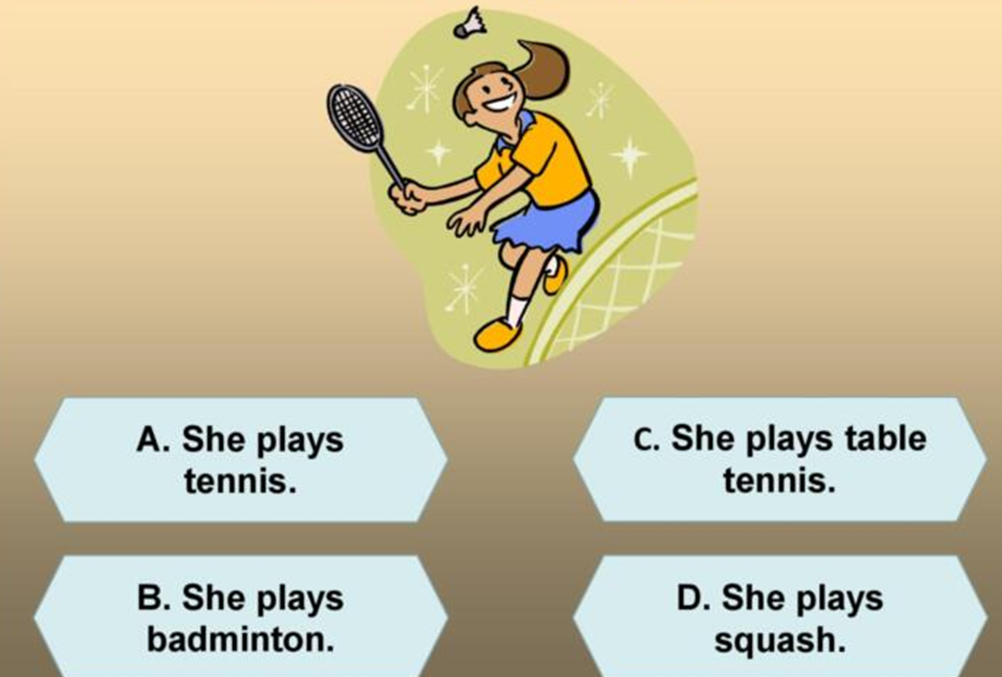
What does she do in her free time?

Slide 18
What does he do in his free time?

Slide 19
What does she do in her free time?

Slide 20
What do they do in their free time?

Slide 21
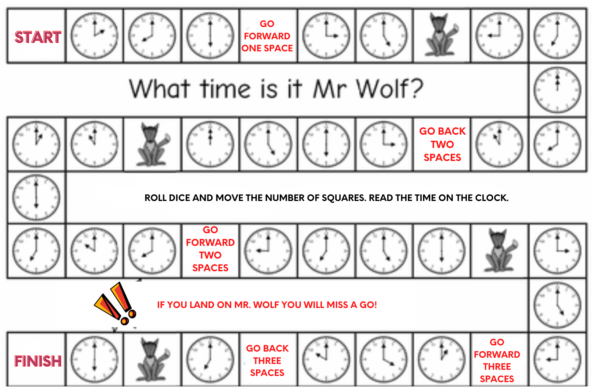
Let’s Play Game

Slide 22
IT'S TIME FOR AN IDIOM EVERY DAY
Time Flies
When time passes quickly.

Slide 23
TODAY’S VOCABULARY
Let's write down the words we already know or what we remember from today's lesson.

Slide 24
What do you do in your free time?

Slide 25
Even if we finish today's lesson here, here are some suggestions for integrating English into your daily life:
Watching: On YouTube (English Conversation)
https://www.youtube.com/watch?v=m1-Bx3h4cio&t=10s
Listening: Podcast “Fluency Fix's Beginner English, Thinking of English)
https://open.spotify.com/episode/4O9JStUhmzDI0WXBknnD04
https://open.spotify.com/show/2OwAg0ckS0mUDPi6HW8FNt
Phone app: Download “Duolingo, Voscreen, Busuu, Memrise, Mondly)
.

Slide 26
Thank you for your participation.
ANY QUESTIONS?
Have a good week. Hope to see you next week.

