Slide 1
DAILY ENGLISH SPEAKING FOR BEGINNERS

Slide 2
LESSON 5

Slide 3
Contacts
2. Daily English Conservation Practice
Topic 2
Transport
Bus/Coach
Train
Plane
New Year Conservation

Slide 4
Bus Vocabulary
Bus stop
Coach station
Ticket
Coach
Shuttle bus
Where is the bus station?
Does it go to the centre?
When is the next bus?

Slide 5
Now let's write down the words and sentences we heard in the bus dialogues video we will watch.

Slide 6
https://www.youtube.com/watch?v=j3J3sykmi5A

Slide 7
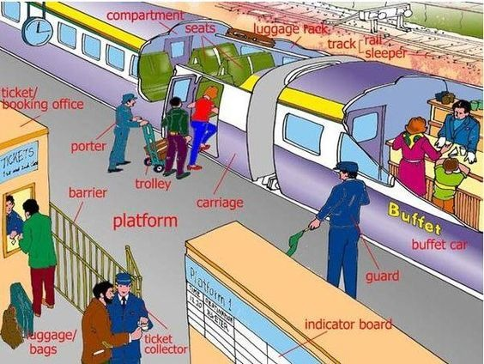
TRAIN

Slide 8
Now let's write down the words and sentences we heard in the train dialogues video we will watch.

Slide 9
https://www.youtube.com/watch?v=nSaVzujGlj4

Slide 10
PLANE

Slide 11
Now let's write down the words and sentences we heard in the plane dialogues video we will watch.

Slide 12
https://www.youtube.com/watch?v=juPlEnOKl48

Slide 13
New Year Conservation

Slide 14
Let's be a group of two and read this dialogue with each other

Slide 15
A: Hello.
B: Hi.
A: Merry Christmas.
B: Same to you.
A: What are your plans for the holidays?
B: I will be visiting friends and family and sharing a Christmas meal.
A: Will you be travelling at all?
B: No, I’ll be staying close to home. What about you, what will you be doing?
A: The same, spending it with friends and family.

Slide 16
B: Will you be travelling anywhere?
A: Possibly, I might go to the beach for New Years Eve.
B: That sounds like a lot of fun.
A: I hope so. What are your plans for New Years?
B: I am going to have a quiet night with some friends.
A: That sounds like a lot of fun too.
B: I wish you a merry Christmas and a happy new year.
A: Same to you and all the best for the new year!
B: Thanks, see you next year.

Slide 17
IT'S TIME FOR AN IDIOM EVERY DAY
Christmas came early (this year)
When someone receives some unexpected good news

Slide 18
TODAY’S VOCABULARY
Let's write down the words we already know or what we remember from today's lesson.

Slide 19
New year wishes

Slide 20
Even if we finish today's lesson here, here are some suggestions for integrating English into your daily life:
Watching: On YouTube (English Conversation)
https://www.youtube.com/watch?v=m1-Bx3h4cio&t=10s
Listening: Podcast “Fluency Fix's Beginner English, Thinking of English)
https://open.spotify.com/episode/4O9JStUhmzDI0WXBknnD04
https://open.spotify.com/show/2OwAg0ckS0mUDPi6HW8FNt
Phone app: Download “Duolingo, Voscreen, Busuu, Memrise, Mondly)
.

Slide 21
Thank you for your participation.
ANY QUESTIONS?
Merry Christmas!!!!
Hope to see you next week.

