Slide 1
DAILY ENGLISH SPEAKING FOR BEGINNERS

Slide 2
LESSON 4

Slide 3
Contents
Daily English Conservation Practice
Topic 1
Shopping
Stop 1: Shopping Centre
Stop 2: Coffee Shop

Slide 4
Useful phrases a shop assistant says
“Can I help you?” “Are you looking for anything in particular?” “Do you need any help at all?” “We don’t have any of these left in stock.”
( = There is no more of something.)

Slide 5
Useful phrases a customer says
“I’m looking for …”
“I’d like to buy…”
Indicating a piece of clothing
“Do you have this in …”
– medium / large / small / extra large / XL
– blue / black / red

Slide 6
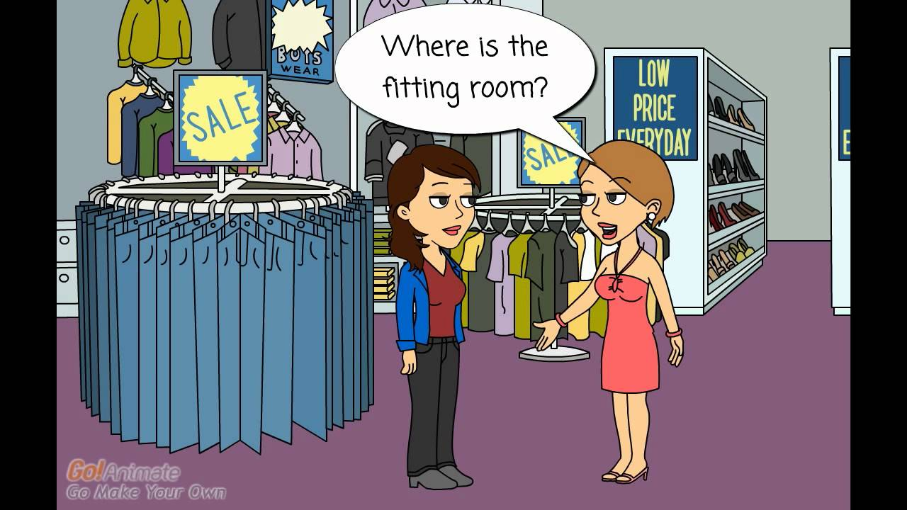
Trying something on
Example shopping conversation
Customer: Can I try this on?
Shop assistant: Sure. The changing rooms are over there…
Later….
Shop assistant: Any good?
Customer: Yes, I will take it.

Slide 7
Paying
Customer: Where I can pay?
Shop assistant: The cash tills are over there.
Customer: Can I pay in cash and by credit card, too?
Cashier: You can pay in cash and by credit card, too.
Customer: Here is my card.
Cashier: Thank you. Have a nice day.
Customer: Thank you, Good bye.

Slide 9
At Coffee Shop- Give Order
Good morning! May I take your order?
Coffee Shop Clerk
Morning! Could I have a large cappuccino, please?
Matt
Certainly. Would you like to add any extra flavours?
No, Thank you.
Matt

Slide 10
Okay. That will be $2.90. Is that dine-in or takeout?
Coffee Shop Clerk
Take-out, please. Here's five dollars. Keep the change.
Matt
Thank you very much. You can pick up your order at the next counter.
Have a nice day.
Matt

Slide 11
https://www.youtube.com/watch?v=Xrh4y45qmOA

Slide 12
IT'S TIME FOR AN IDIOM EVERY DAY
Cheap as chips or As cheap as chips
Very inexpensive.

Slide 13
TODAY’S VOCABULARY
Let's write down the words we already know or what we remember from today's lesson.

Slide 14
Let’s buy something

Slide 15
Even if we finish today's lesson here, here are some suggestions for integrating English into your daily life:
Watching: On YouTube (English Conversation)
https://www.youtube.com/watch?v=m1-Bx3h4cio&t=10s
Listening: Podcast “Fluency Fix's Beginner English, Thinking of English)
https://open.spotify.com/episode/4O9JStUhmzDI0WXBknnD04
https://open.spotify.com/show/2OwAg0ckS0mUDPi6HW8FNt
Phone app: Download “Duolingo, Voscreen, Busuu, Memrise, Mondly)
.

Slide 16
Thank you for your participation.
ANY QUESTIONS?
Have a good week. Hope to see you next week.

