Slide 1
DAILY ENGLISH SPEAKING FOR BEGINNERS

Slide 2
LESSON 3

Slide 3
Contents
Introducing your family
Introducing Other People
Alphabet

Slide 4
Family- Family members

Slide 6
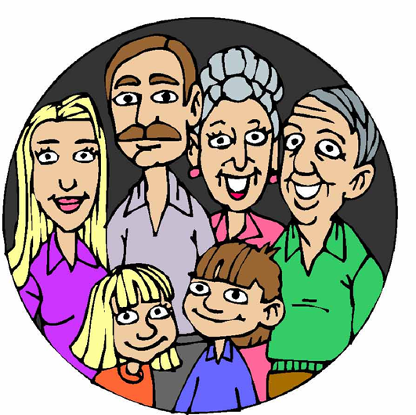
Introducing your family
This is my mother/father.
This is my wife/husband.
There are five people in my family. (My mother, my father, my older brother/sister, my younger brother and me)
I have two brothers.

Slide 7
Let’s play game
How many family members can you find in the puzzle in 1 minute?

Slide 9
LET’S CHECK

Slide 10
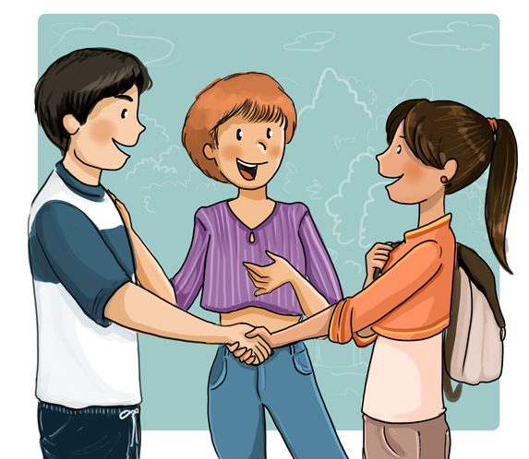
Introducing Other People
Introducing Other People
This is my friend, Jack. Hi Jack. I'm Linda
•
my brother, Bob.
•
my sister, Cindy.
•
my father, Mr. Harris.
•
my mother, Mrs. Harris.
•
my teacher, Ms. Watson.
•
my student, Carrie.
•
my friend, Mary Jones.
•
my boss, Mr. Ritter.
•
my co-worker, Penny Pitcher.2. Nice to meet you. Nice to meet you too.
2.Hi Jack. I'm Linda.
4.Nice to meet you too.
1.This is my friend, Jack.
3.Nice to meet you.

Slide 13
SPELL YOUR NAME
A)Hi Emily, this is my brother Brian.
B)Hi Bryan nice to meet you.
C)Oh no, my name is Brian.
B)Can you spell your name please?
C)B-R-I-A-N

Slide 14
LET’S SPELL YOUR NAME

Slide 15
IT'S TIME FOR AN IDIOM EVERY DAY
Piece of cake
Something easily done

Slide 16
TODAY’S VOCABULARY
Let's write down the words we already know or what we remember from today's lesson.

Slide 17
Introducing your family

Slide 18
Even if we finish today's lesson here, here are some suggestions for integrating English into your daily life:
Watching: On YouTube (English Conversation)
https://www.youtube.com/watch?v=m1-Bx3h4cio&t=10s
Listening: Podcast “Fluency Fix's Beginner English, Thinking of English)
https://open.spotify.com/episode/4O9JStUhmzDI0WXBknnD04
https://open.spotify.com/show/2OwAg0ckS0mUDPi6HW8FNt
Phone app: Download “Duolingo, Voscreen, Busuu, Memrise, Mondly)
.

Slide 19
Thank you for your participation.
ANY QUESTIONS?
Have a good week. Hope to see you next week.

