Slide 1
DAILY ENGLISH SPEAKING FOR BEGINNERS

Slide 2
LESSON 2

Slide 3
Contents
Tell about yourself
Learn to say your age(Ordinal Numbers)
Some country name
Jobs vocabulary

Slide 4
Tell about yourself

Slide 9
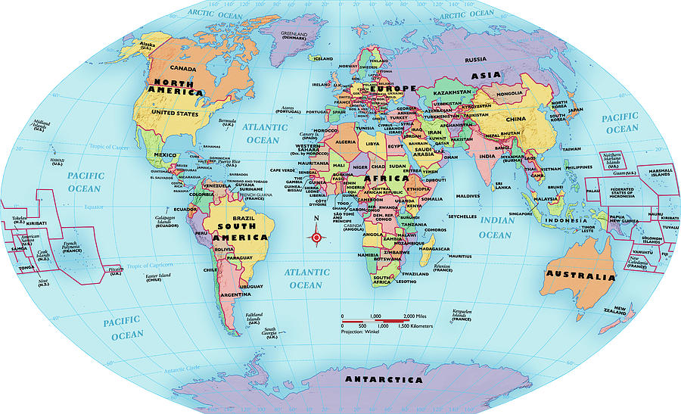
SOME COUNTRY NAMES

Slide 11
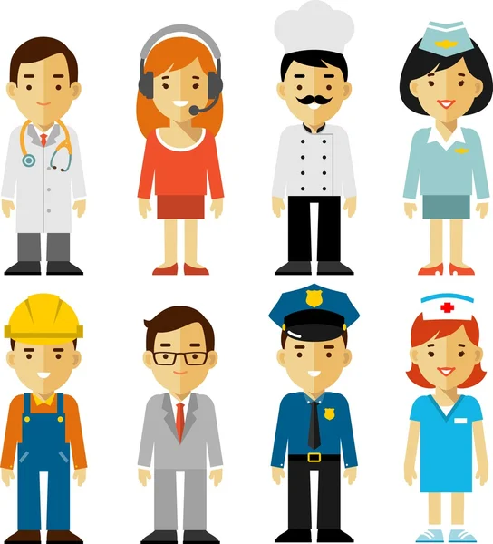
JOBS VOCABULARY

Slide 13
Numbers

Slide 15
How old are you?

Slide 16
How old are you?
Teacher
I am _______ years old.
Hyun-woo

Slide 17
How old is she/he?
Teacher
She/he is ______.
Hyun-woo

Slide 18
Let’s Play Game
Let the players sitting next to each other take turns counting starting from 1.
When counting, numbers corresponding to multiples of 5, such as 5, 10, 15, should be called "BOOM".
If you forget to say "BOOM" while it's your turn, you're out of the game.
You must continue in this manner until the last player is left.
We will count to 20. Every time twenty (boom) is said, it will start from 1.

Slide 19
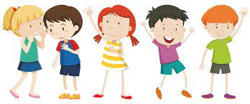
Example

Slide 20
IT'S TIME FOR AN IDIOM EVERY DAY
Take It Easy
Just do things step by step; relax or calm down.

Slide 21
TODAY’S VOCABULARY
Let's write down the words we already know or what we remember from today's lesson.

Slide 22
Introduce yourself

Slide 23
Even if we finish today's lesson here, here are some suggestions for integrating English into your daily life:
Watching: On YouTube (English Conversation)
https://www.youtube.com/watch?v=m1-Bx3h4cio&t=10s
Listening: Podcast “Fluency Fix's Beginner English, Thinking of English)
https://open.spotify.com/episode/4O9JStUhmzDI0WXBknnD04
https://open.spotify.com/show/2OwAg0ckS0mUDPi6HW8FNt
Phone app: Download “Duolingo, Voscreen, Busuu, Memrise, Mondly)
.

Slide 24
Thank you for your participation.
ANY QUESTIONS?
Have a good week. Hope to see you next week.

