Slide 1
DAILY ENGLISH SPEAKING FOR BEGINNERS

Slide 2
LESSON 1

Slide 3
Contents
Starting an English Conservation
Using Small Talk to End a Conversation
Introducing Yourself
Making Small Talk in English

Slide 4
Starting an English Conservation
Informal greetings: Arriving
Hello!
Hi!
Hey!
Greetings!

Slide 5
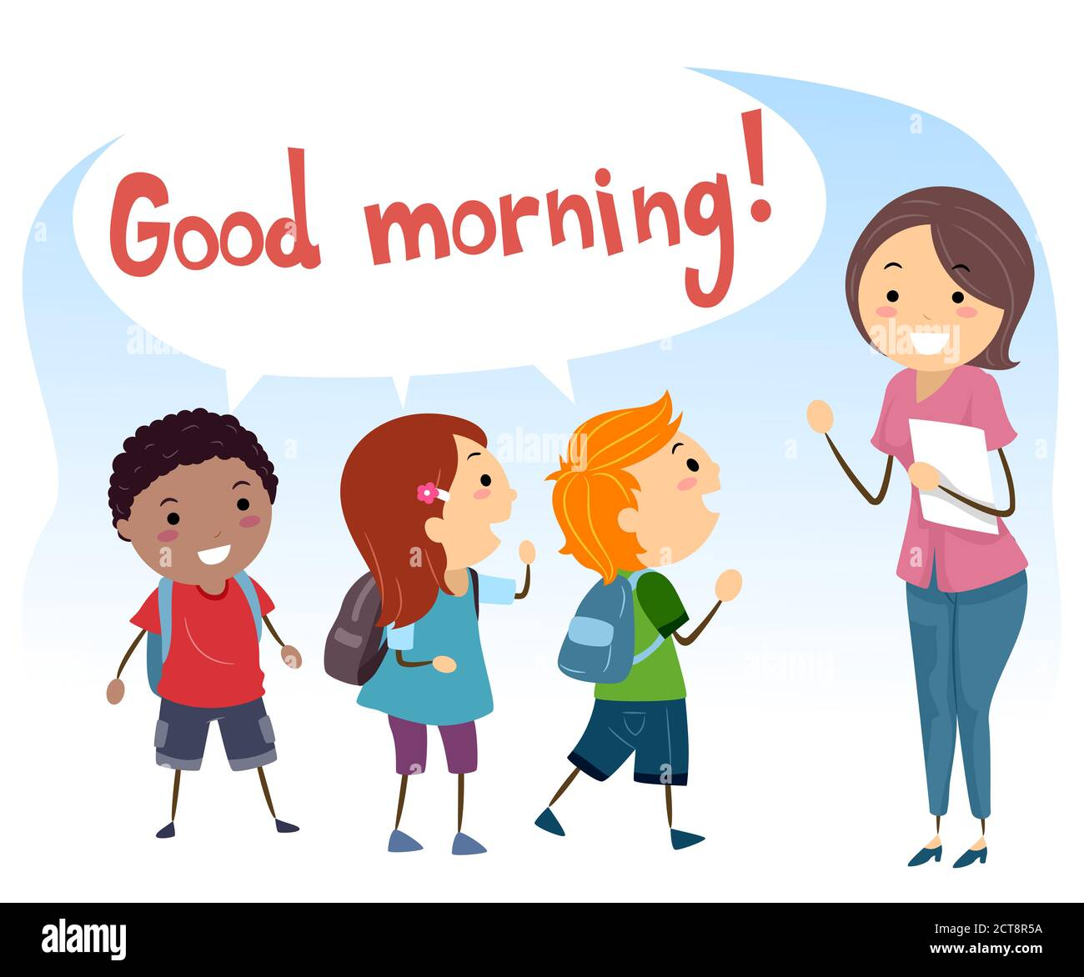
Formal greetings: Arriving
Good morning! (Reserved for any time before noon.)
Good afternoon! (Typically used between 12 and 5-6 p.m.)
Good evening! (Any time after 6 p.m.)

Slide 6
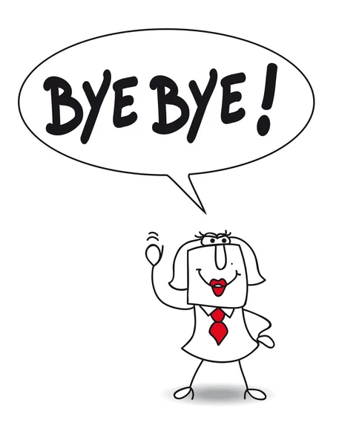
Using Small Talk to End a Conversation
Formal Greetings: Departing
Use these greetings when you say goodbye at the end of the day. These greetings are appropriate for work and other formal situations.
Good morning / afternoon / evening.
It was a pleasure seeing you.
Goodbye.
Take care/Farewell.
See you soon. (someone you see regularly)
Goodnight. (Use after 8 p.m.)

Slide 7
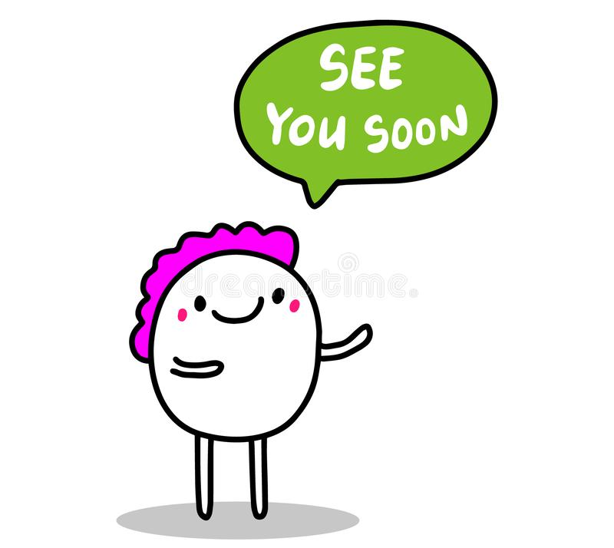
Informal Greetings: Departing
Use these greetings when saying goodbye in an informal situation.
Nice seeing you!
Goodbye / Bye
See you later

Slide 8
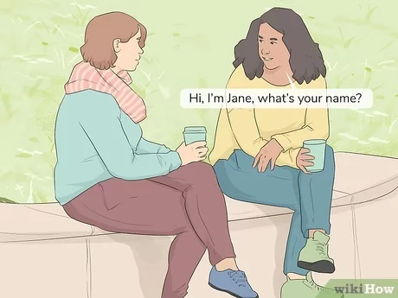
Introducing Yourself
Hello, I’m John, what is your name?
Hello John, I’m Jackie, pleased to meet you.
(Use first name in informal situations)
Hello, my name is John Kennedy, what is your name?
Hello John/Mr Kennedy, my name is Jackie O'Neill, it is nice to meet you.
(Use full name in business and formal situations)
(It’s/it is) nice to meet you.
(It’s/it is) good to meet you.
(It’s/it is) a pleasure to meet you.
(I’m/I am) pleased to meet you.
(It’s/It is) nice to meet you too

Slide 9
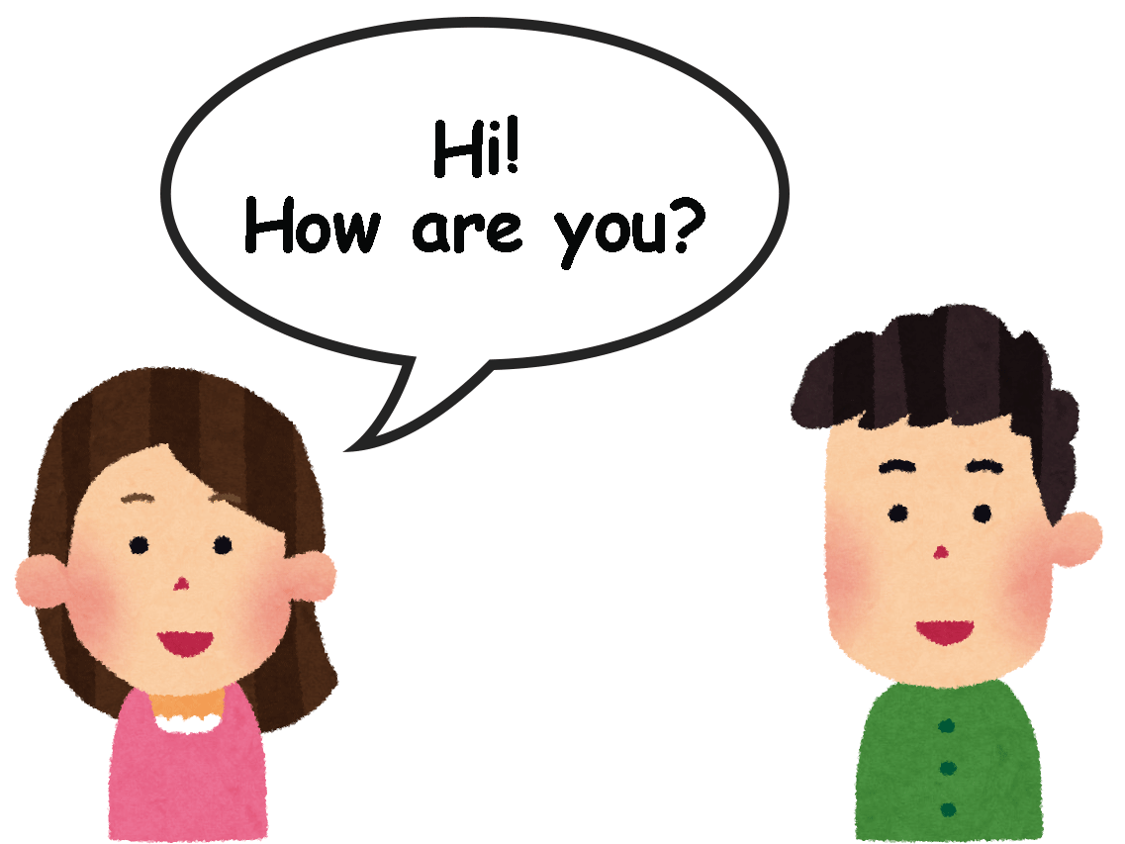
Making Small Talk in English
How are you? / How are you doing? (Neutral.)
How’s it going? (More informal.)
How are things? (Informal.)
What’s up? (Very informal.)
Typical a English conversation
Hi Adam. How are you?
I’m well, thank you Sarah. How are you?
A) It’s going well, thank you. I am glad to see you.
B) Me too. See you again soon.
A) See you Sarah.

Slide 10
https://www.youtube.com/watch?v=aUJjkHaNNRo

Slide 11
Let’s play game
Our friend who catches the ball first will say his/her name.
Then he/she will ask what's your name as he throws the ball to any classmate he/she wants.
The person who catches the ball will say his/her name first.
Then he/she will say the name of his/her friend who throws the ball and say it's nice to meet you.
If desired, phrases such as "how are you?" that we learned today can be added.
This cycle will continue until everyone in the class has their turn.

Slide 12
Example
2
Hello. My name is Emily.
Nice to meet you John.
Throws the ball to a different friend…
1
Hi! My name is John.
While throwing the ball to the friend she/he ask:
What's your name?

Slide 13
IT'S TIME FOR AN IDIOM EVERY DAY
Long time, no see
it is a long time since we last met (used as a greeting).

Slide 14
TODAY’S VOCABULARY
Let's write down the words we already know or what we remember from today's lesson.

Slide 15
Create your own conversation

Slide 16
Even if we finish today's lesson here, here are some suggestions for integrating English into your daily life:
Watching: On YouTube (English Conversation)
https://www.youtube.com/watch?v=m1-Bx3h4cio&t=10s
Listening: Podcast “Fluency Fix's Beginner English, Thinking of English)
https://open.spotify.com/episode/4O9JStUhmzDI0WXBknnD04
https://open.spotify.com/show/2OwAg0ckS0mUDPi6HW8FNt
Phone app: Download “Duolingo, Voscreen, Busuu, Memrise, Mondly)
.

Slide 17
Thank you for your participation.
ANY QUESTIONS?
Have a good week. Hope to see you next week.

